Slide 1
UMD DATA605 - Big Data Systems
Parallel Databases
GP Saggese
gsaggese@umd.edu
with thanks to Alan Sussman, Amol Deshpande

Slide 2
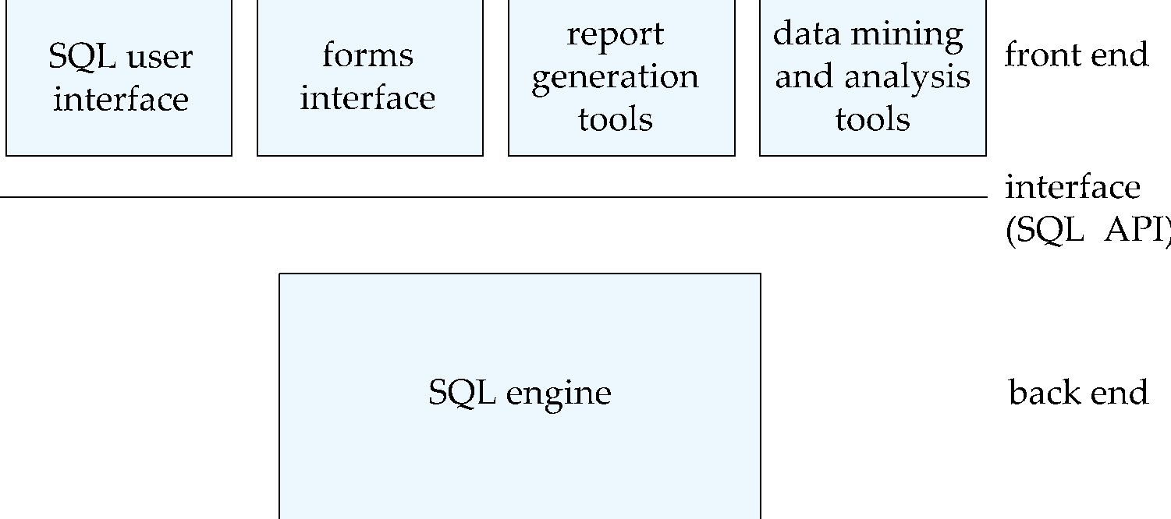
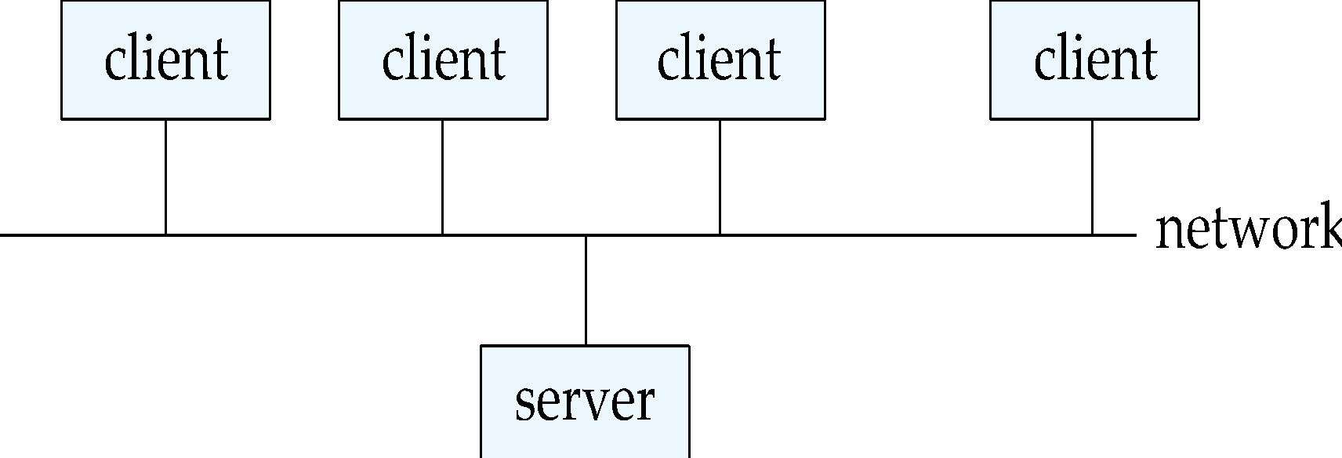
Client-Server Systems
Database functionality can be divided into:
Back-end: manages access, query evaluation and optimization, concurrency control and recovery
Front-end: consists of tools such as forms, report-writers, and graphical user interface (GUI) facilities
The interface between the front-end and the back-end is through SQL or through an application programming interface (API)

Slide 3
Parallel Databases
Internet created the need for large DBs, e.g.,
store petabytes of data
process thousands of transactions per second
The set-oriented nature of DB queries lends itself to parallelization
Database operations are embarrassingly parallel
E.g. Consider a join between R and S on R.b = S.b
Parallel DBs
More transactions per second, or less time per query
Throughput vs. response time
Speedup vs scaleup
But, perfect speedup doesn't happen
Start-up costs
Interference
Skew

Slide 4
Parallel Systems
Parallel systems consist of:
multiple processors
multiple disks
connected by a fast interconnection network
Coarse-grain parallel machine
Small number of powerful processors
Fine grain parallel (aka massively parallel) machine
Thousands of smaller processors
Much larger degree of parallelism
Typically no shared memory
Two main performance measures:
throughput: the number of tasks that can be completed in a given time interval
Increase throughput by processing many transactions in parallel
response time (aka latency): the amount of time it takes to complete a single task from the time it is submitted
Decrease response time by performing subtasks of each transaction in parallel

Slide 5
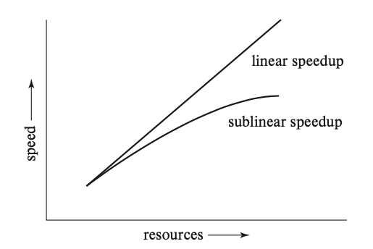
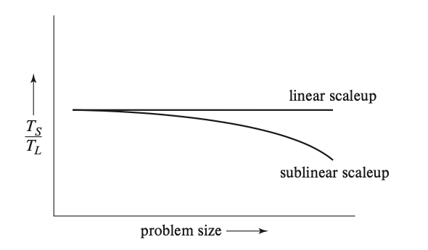
Speed-Up and Scale-Up
Consider a system with increasing number of processors, memory, and disks (N)
Speed-up: a fixed-sized problem executing on a small system is given to a system which is N-times larger
Measured by:
speedup = small system elapsed time
large system elapsed time
Speedup is linear if equation equals N
Scale-up: increase the size of both the problem and the system
N-times larger system to perform N-times larger job
Measured by:
scaleup = small system / problem time
big system / problem time
Scale up is linear if equation equals 1

Slide 6
Factors Limiting Speed-up and Scale-up
Speedup and scaleup are often sublinear due to:
Sequential computation: Some pieces of the computation can be executed in parallel, other must be executed sequentially
Amdahl’s Law
p = fraction of computation that can be parallelized
n = nodes providing linear speed-up
T_p = (1-p)T + (p/n)T
Speedup = 1 / ((1 - p) + p / n)
If 90% is parallelizable, the max speed-up is 10x
Startup costs: Cost of starting up multiple processes may dominate computation time
Interference: Processes accessing shared resources (e.g., system bus, disks, or locks) compete with each other
Time spent waiting on other processes, rather than performing useful work
Skew: Increasing the degree of parallelism increases the variance in response time of parallely executed tasks
Difficult to keep split a task in equally sized parts
Overall execution time determined by slowest of parallely executing tasks

Slide 7
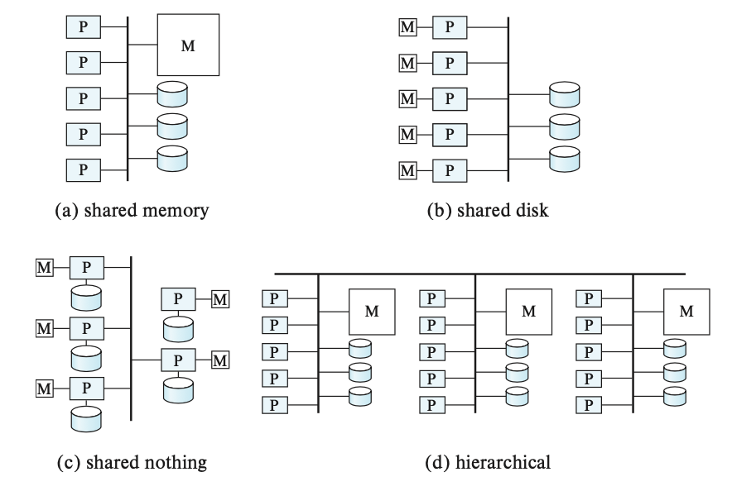
Topology of parallel Systems
How to organize computation and storage
M = memory
P = processors
D = disks
Problems are
Cache coherency
Data communication
Fault tolerance
Resource congestion

Slide 8
Parallel Databases
Shared Memory
Shared Disk
Shared Nothing
Communication between processors
Extremely fast
Disk interconnect is very fast
Over a LAN, so slowest
Scalability?
Not beyond 32 or 64 or so (memory bus is the bottleneck)
Not very scalable (disk interconnect is the bottleneck)
Very very scalable
Notes
Cache-coherency an issue
Transactions complicated; natural fault-tolerance.
Distributed transactions are complicated (deadlock detection etc);
Main use
Low degrees of parallelism
Not used very often
Everywhere

Slide 9
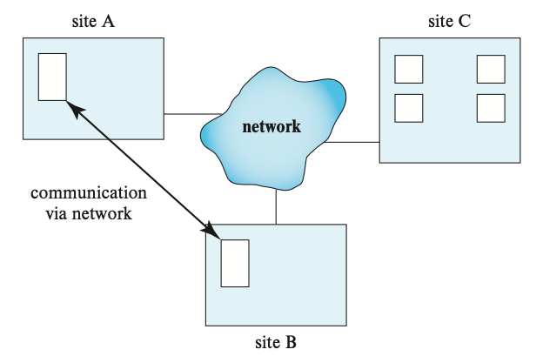
Distributed DB Systems
The DB is stored on nodes located at geographically separated sites
Communicate through dedicated high-speed private networks or Internet
Typically not done for performance reasons
For that, use a parallel system
Done because of necessity
Imagine a large corporation with offices all over the world
Also, for redundancy and for disaster recovery reasons
Wide-area networks (WAN)
Lower bandwidth
Higher latency
Greater probability of failures (compared to networks in a single data center)
Network-link failures may result in network partition
No sharing of memory or disks
Replication across geographically separated centers
Achieve high-availability despite failures (e.g., natural disasters, power outage, hacker attacks)
Nodes can have different size and functions (vs parallel DBs have nodes that are similar)

Slide 10
Atomicity and concurrency in Distributed DB Systems
Atomicity is required even for parallel and distributed DBs
One solution: two-phase commit (2PC)
Each node execute the transaction, reaching a "ready state"
The commit decision is delegated to a single coordinator node
If each node reaches the ready state, the coordinator decides to commit
If a node aborts at any code, the coordinator aborts the transaction
If a node fails in ready state, it recovers from failure (e.g., write-ahead logs on stable storage) and it can either commit or abort
Other solutions: distributed consensus
Autonomy issues
Even within an organization, people tend to be protective of their unit / department
E.g., for administering systems, patching, updating
Concurrency issues
Locks / deadlock management
Distributed DBs works better for query processing
Since we are only reading the data

Slide 11
Parallel Databases
Introduction
I/O Parallelism
Interquery Parallelism
Intraquery Parallelism
Intraoperation Parallelism
Interoperation Parallelism
Design of Parallel Systems
Silbershatz: Chap 22

Slide 12
Introduction
Parallel machines are becoming quite common and affordable
Prices of microprocessors, memory and disks have dropped sharply
Recent desktop computers feature multiple processors and this trend is projected to accelerate
Databases are growing increasingly large
large volumes of transaction data are collected and stored for later analysis
multimedia objects like images are increasingly stored in databases
Large-scale parallel database system increasingly used for:
storing large volumes of data
processing time-consuming decision-support queries
providing high throughput for transaction processing

Slide 13
Parallelism in Databases
Data can be partitioned across multiple disks for parallel I/O
Individual relational operations (e.g., sort, join, aggregation) can be executed in parallel
data can be partitioned and each processor can work independently on its own partition.
Queries are expressed in high level language (SQL, translated to relational algebra)
makes parallelization easier.
Different queries can be run in parallel with each other
Concurrency control takes care of conflicts.
Thus, databases naturally lend themselves to parallelism

Slide 14
I/O Parallelism
Reduce the time required to retrieve relations from disk by partitioning the relations on multiple disks
Horizontal partitioning – tuples of a relation are divided among many disks such that each tuple resides on one disk
Partitioning techniques (number of disks = n):
Round-robin:
Send the i^{th} tuple inserted in the relation to disk i mod n.
Hash partitioning:
Choose one or more attributes as the partitioning attributes.
Choose hash function h with range 0…n - 1
Let i denote result of hash function h applied to the partitioning attribute value of a tuple. Send tuple to disk i.

Slide 15
I/O Parallelism (Cont.)
Range partitioning:
Choose an attribute as the partitioning attribute.
A partitioning vector [v_{o}, v₁, ..., v_{n-2}] is chosen.
Let v be the partitioning attribute value of a tuple. Tuples such that v_{i} ≤ v_{i+1} go to disk I + 1. Tuples with v < v₀ go to disk 0 and tuples with v ≥ v_{n-2} go to disk n-1.
E.g., with a partitioning vector [5,11], a tuple with partitioning attribute value of 2 will go to disk 0, a tuple with value 8 will go to disk 1, while a tuple with value 20 will go to disk2.

Slide 16
Comparison of Partitioning Techniques
Evaluate how well partitioning techniques support the following types of data access:
1. Scanning the entire relation.
2. Locating a tuple associatively – point queries.
E.g., r.A = 25.
3. Locating all tuples such that the value of a given attribute lies within a specified range – range queries.
E.g., 10 ≤ r.A < 25.

Slide 17
Comparison of Partitioning Techniques (Cont.)
Round robin:
Advantages
Best suited for sequential scan of entire relation on each query.
All disks have almost an equal number of tuples; retrieval work is thus well balanced between disks.
Range queries are difficult to process
No clustering -- tuples are scattered across all disks

Slide 18
Comparison of Partitioning Techniques (Cont.)
Hash partitioning:
Good for sequential access
Assuming hash function is good, and partitioning attributes form a key, tuples will be equally distributed between disks
Retrieval work is then well balanced between disks.
Good for point queries on partitioning attribute
Can lookup single disk, leaving others available for answering other queries.
Index on partitioning attribute can be local to disk, making lookup and update more efficient
No clustering, so difficult to answer range queries

Slide 19
Comparison of Partitioning Techniques (Cont.)
Range partitioning:
Provides data clustering by partitioning attribute value.
Good for sequential access
Good for point queries on partitioning attribute: only one disk needs to be accessed.
For range queries on partitioning attribute, one to a few disks may need to be accessed
Remaining disks are available for other queries.
Good if result tuples are from one to a few blocks.
If many blocks are to be fetched, they are still fetched from one to a few disks, and potential parallelism in disk access is wasted
Example of execution skew.

Slide 20
Partitioning a Relation across Disks
If a relation contains only a few tuples which will fit into a single disk block, then assign the relation to a single disk.
Large relations are preferably partitioned across all the available disks.
If a relation consists of m disk blocks and there are n disks available in the system, then the relation should be allocated min(m,n) disks.

Slide 21
Handling of Skew
The distribution of tuples to disks may be skewed
Some disks have many tuples, while others may have fewer tuples
Types of skew:
Attribute-value skew.
Some values appear in the partitioning attributes of many tuples; all the tuples with the same value for the partitioning attribute end up in the same partition.
Can occur with range-partitioning and hash-partitioning.
Partition skew.
With range-partitioning, badly chosen partition vector may assign too many tuples to some partitions and too few to others.
Less likely with hash-partitioning if a good hash-function is chosen.

Slide 22
Handling Skew in Range-Partitioning
To create a balanced partitioning vector (assuming partitioning attribute forms a key of the relation):
Sort the relation on the partitioning attribute.
Construct the partition vector by scanning the relation in sorted order as follows.
After every 1/n^{th} of the relation has been read, the value of the partitioning attribute of the next tuple is added to the partition vector.
n denotes the number of partitions to be constructed.
Duplicate entries or imbalances can result if duplicates are present in partitioning attributes.
Alternative technique based on histograms used in practice

Slide 23
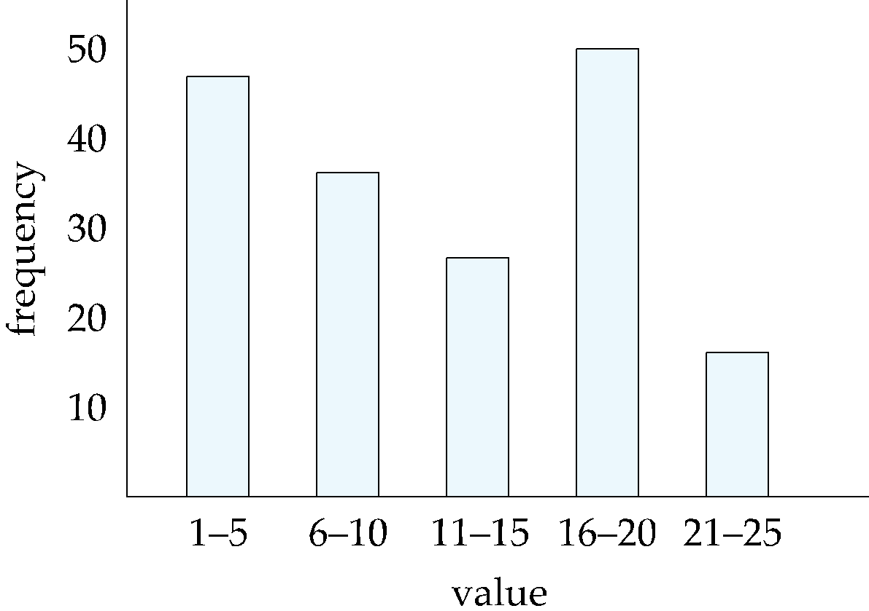
Handling Skew using Histograms
Balanced partitioning vector can be constructed from histogram in a relatively straightforward fashion
Assume uniform distribution within each range of the histogram
Histogram can be constructed by scanning relation, or sampling (blocks containing) tuples of the relation

Slide 24
Handling Skew Using Virtual Processor Partitioning
Skew in range partitioning can be handled elegantly using virtual processor partitioning:
create a large number of partitions (say 10 to 20 times the number of processors)
Assign virtual processors to partitions either in round-robin fashion or based on estimated cost of processing each virtual partition
Basic idea:
If any normal partition would have been skewed, it is very likely the skew is spread over a number of virtual partitions
Skewed virtual partitions get spread across a number of processors, so work gets distributed evenly!

Slide 25
Interquery Parallelism
Queries/transactions execute in parallel with one another.
Increases transaction throughput; used primarily to scale up a transaction processing system to support a larger number of transactions per second.
Easiest form of parallelism to support, particularly in a shared-memory parallel database, because even sequential database systems support concurrent processing.
More complicated to implement on shared-disk or shared-nothing architectures
Locking and logging must be coordinated by passing messages between processors.
Data in a local buffer may have been updated at another processor.
Cache-coherency has to be maintained — reads and writes of data in buffer must find latest version of data.

Slide 26
Cache Coherency Protocol
Example of a cache coherency protocol for shared disk systems:
Before reading/writing to a page, the page must be locked in shared/exclusive mode.
On locking a page, the page must be read from disk
Before unlocking a page, the page must be written to disk if it was modified.
More complex protocols with fewer disk reads/writes exist.
Cache coherency protocols for shared-nothing systems are similar. Each database page is assigned a home processor. Requests to fetch the page or write it to disk are sent to the home processor.

Slide 27
Intraquery Parallelism
Execution of a single query in parallel on multiple processors/disks; important for speeding up long-running queries.
Two complementary forms of intraquery parallelism:
Intraoperation Parallelism – parallelize the execution of each individual operation in the query.
Interoperation Parallelism – execute the different operations in a query expression in parallel.
The first form scales better with increasing parallelism because the number of tuples processed by each operation is typically more than the number of operations in a query.

Slide 28
Parallel Processing of Relational Operations
Our discussion of parallel algorithms assumes:
read-only queries
shared-nothing architecture
n processors, P₀, ..., P_{n-1}, and n disks D₀, ..., D_{n-1}, where disk D_{i} is associated with processor P_{i}.
If a processor has multiple disks they can simply simulate a single disk D_{i}.
Shared-nothing architectures can be efficiently simulated on shared-memory and shared-disk systems.
Algorithms for shared-nothing systems can thus be run on shared-memory and shared-disk systems.
However, some optimizations may be possible.

Slide 29
Parallel Sort
Range-Partitioning Sort
Choose processors P₀, ..., P_{m}, where m ≤ n -1 to do sorting.
Create range-partition vector with m entries, on the sorting attributes
Redistribute the relation using range partitioning
all tuples that lie in the i^{th} range are sent to processor P_{i}
P_{i} stores the tuples it received temporarily on disk D_{i}.
This step requires I/O and communication overhead.
Each processor P_{i} sorts its partition of the relation locally.
Each processors executes same operation (sort) in parallel with other processors, without any interaction with the others (data parallelism).
Final merge operation is trivial: range-partitioning ensures that, for 1 j m, the key values in processor P^{i} are all less than the key values in P_{j}.

Slide 30
Parallel Sort (Cont.)
Parallel External Sort-Merge
Assume the relation has already been partitioned among disks D₀, ..., D_{n-1} (in whatever manner).
Each processor P_{i} locally sorts the data on disk D_{i}.
The sorted runs on each processor are then merged to get the final sorted output.
Parallelize the merging of sorted runs as follows:
The sorted partitions at each processor P_{i} are range-partitioned across the processors P₀, ..., P_{m-1}.
Each processor P_{i} performs a merge on the streams as they are received, to get a single sorted run.
The sorted runs on processors P₀,..., P_{m-1} are concatenated to get the final result.

Slide 31
Parallel Join
The join operation requires pairs of tuples to be tested to see if they satisfy the join condition, and if they do, the pair is added to the join output.
Parallel join algorithms attempt to split the pairs to be tested over several processors. Each processor then computes part of the join locally.
In a final step, the results from each processor can be collected together to produce the final result.

Slide 32
Partitioned Join
For equi-joins and natural joins, it is possible to partition the two input relations across the processors, and compute the join locally at each processor.
Let r and s be the input relations, and we want to compute r _{r.A=s.B} s.
r and s each are partitioned into n partitions, denoted r₀, r₁, ..., r_{n-1} and s₀, s₁, ..., s_{n-1}.
Can use either range partitioning or hash partitioning.
r and s must be partitioned on their join attributes r.A and s.B), using the same range-partitioning vector or hash function.
Partitions r_{i} and s_{i} are sent to processor P_{i},
Each processor P_{i} locally computes r_{i} _{ri.A=si.B} s_{i}. Any of the standard join methods can be used.

Slide 33
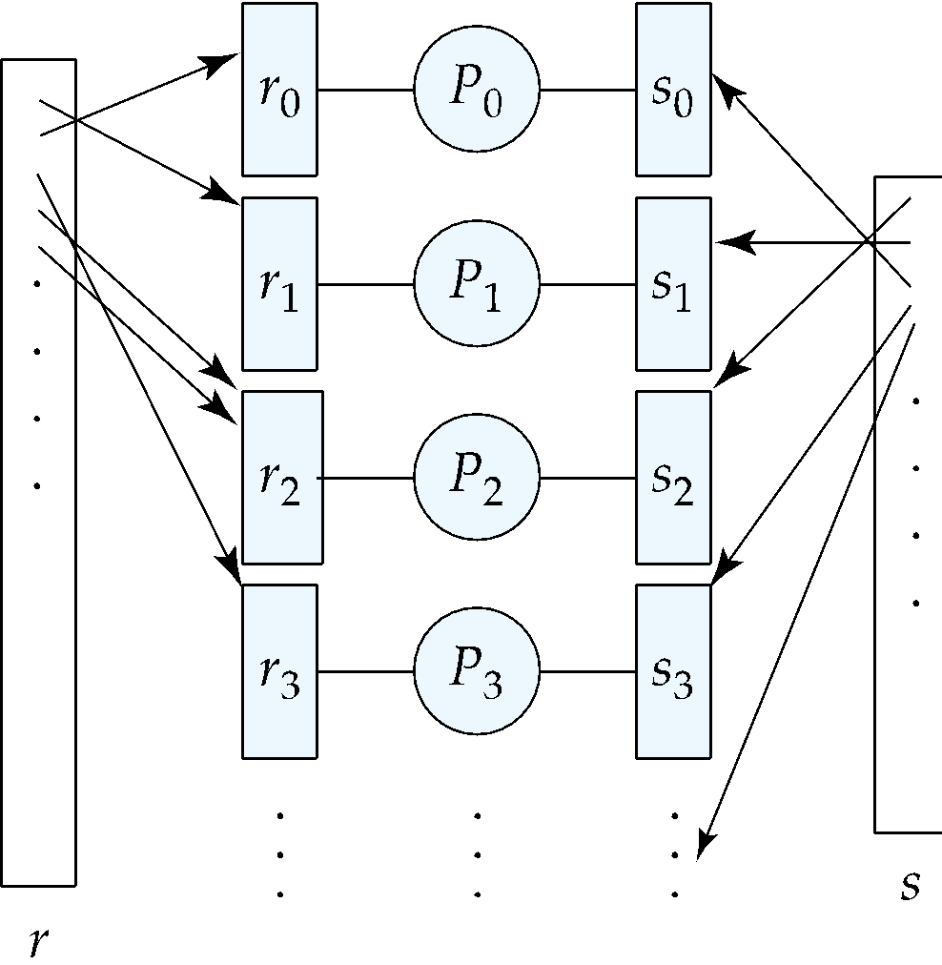
Partitioned Join (Cont.)

Slide 34
Fragment-and-Replicate Join
Partitioning not possible for some join conditions
E.g., non-equijoin conditions, such as r.A > s.B.
For joins where partitioning is not applicable, parallelization can be accomplished by fragment and replicate technique
Depicted on next slide
Special case – asymmetric fragment-and-replicate:
One of the relations, say r, is partitioned; any partitioning technique can be used.
The other relation, s, is replicated across all the processors.
Processor P_{i} then locally computes the join of r_{i} with all of s using any join technique.

Slide 35
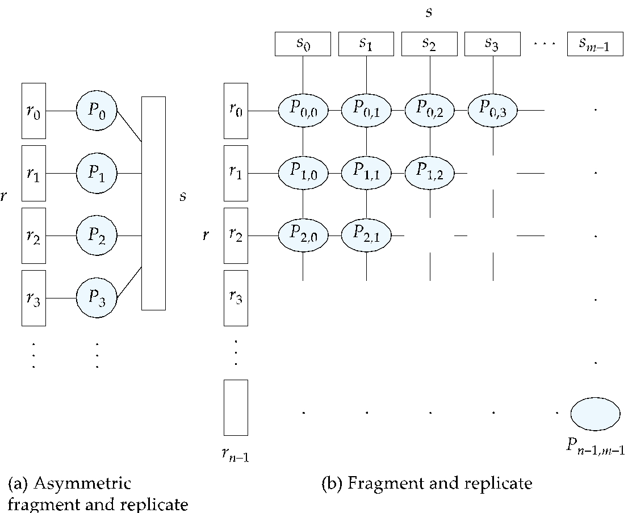
Depiction of Fragment-and-Replicate Joins

Slide 36
Fragment-and-Replicate Join (Cont.)
General case: reduces the sizes of the relations at each processor.
r is partitioned into n partitions,r₀, r₁, ..., r _{n-1};s is partitioned into m partitions, s₀, s₁, ..., s_{m-1}.
Any partitioning technique may be used.
There must be at least m * n processors.
Label the processors as
P_{0,0}, P_{0,1}, ..., P_{0,m-1}, P_{1,0}, ..., P_{n-1m-1}.
P_{i,j} computes the join of r_{i} with s_{j}. In order to do so, r_{i} is replicated to P_{i,0}, P_{i,1}, ..., P_{i,m-1}, while s_{i} is replicated to P_{0,i}, P_{1,i}, ..., P_{n-1,i}
Any join technique can be used at each processor P_{i,j}.

Slide 37
Fragment-and-Replicate Join (Cont.)
Both versions of fragment-and-replicate work with any join condition, since every tuple in r can be tested with every tuple in s.
Usually has a higher cost than partitioning, since one of the relations (for asymmetric fragment-and-replicate) or both relations (for general fragment-and-replicate) have to be replicated.
Sometimes asymmetric fragment-and-replicate is preferable even though partitioning could be used.
E.g., say s is small and r is large, and already partitioned. It may be cheaper to replicate s across all processors, rather than repartition r and s on the join attributes.

Slide 38
Partitioned Parallel Hash-Join
Parallelizing partitioned hash join:
Assume s is smaller than r and therefore s is chosen as the build relation.
A hash function h₁ takes the join attribute value of each tuple in s and maps this tuple to one of the n processors.
Each processor P_{i} reads the tuples of s that are on its disk D_{i}, and sends each tuple to the appropriate processor based on hash function h₁. Let s_{i} denote the tuples of relation s that are sent to processor P_{i}.
As tuples of relation s are received at the destination processors, they are partitioned further using another hash function, h₂, which is used to compute the hash-join locally. (Cont.)

Slide 39
Partitioned Parallel Hash-Join (Cont.)
Once the tuples of s have been distributed, the larger relation r is redistributed across the m processors using the hash function h₁
Let r_{i} denote the tuples of relation r that are sent to processor P_{i}.
As the r tuples are received at the destination processors, they are repartitioned using the function h₂
(just as the probe relation is partitioned in the sequential hash-join algorithm).
Each processor P_{i} executes the build and probe phases of the hash-join algorithm on the local partitions r_{i} and s of r and s to produce a partition of the final result of the hash-join.
Note: Hash-join optimizations can be applied to the parallel case
e.g., the hybrid hash-join algorithm can be used to cache some of the incoming tuples in memory and avoid the cost of writing them and reading them back in.

Slide 40
Parallel Nested-Loop Join
Assume that
relation s is much smaller than relation r and that r is stored by partitioning.
there is an index on a join attribute of relation r at each of the partitions of relation r.
Use asymmetric fragment-and-replicate, with relation s being replicated, and using the existing partitioning of relation r.
Each processor P_{j} where a partition of relation s is stored reads the tuples of relation s stored in D_{j}, and replicates the tuples to every other processor P_{i}.
At the end of this phase, relation s is replicated at all sites that store tuples of relation r.
Each processor P_{i} performs an indexed nested-loop join of relation s with the i^{th} partition of relation r.

Slide 41
Other Relational Operations
Selection σ_{θ}(r)
If θ is of the form a_{i} = v, where a_{i} is an attribute and v a value.
If r is partitioned on a_{i} the selection is performed at a single processor.
If θ is of the form l <= a_{i} <= u (i.e., θ is a range selection) and the relation has been range-partitioned on a_{i}
Selection is performed at each processor whose partition overlaps with the specified range of values.
In all other cases: the selection is performed in parallel at all the processors.

Slide 42
Other Relational Operations (Cont.)
Duplicate elimination
Perform by using either of the parallel sort techniques
eliminate duplicates as soon as they are found during sorting.
Can also partition the tuples (using either range- or hash- partitioning) and perform duplicate elimination locally at each processor.
Projection
Projection without duplicate elimination can be performed as tuples are read in from disk in parallel.
If duplicate elimination is required, any of the above duplicate elimination techniques can be used.

Slide 43
Grouping/Aggregation
Partition the relation on the grouping attributes and then compute the aggregate values locally at each processor.
Can reduce cost of transferring tuples during partitioning by partly computing aggregate values before partitioning.
Consider the sum aggregation operation:
Perform aggregation operation at each processor P_{i} on those tuples stored on disk D_{i}
results in tuples with partial sums at each processor.
Result of the local aggregation is partitioned on the grouping attributes, and the aggregation performed again at each processor P_{i} to get the final result.
Fewer tuples need to be sent to other processors during partitioning.

Slide 44
Cost of Parallel Evaluation of Operations
If there is no skew in the partitioning, and there is no overhead due to the parallel evaluation, expected speed-up will be 1/n
If skew and overheads are also to be taken into account, the time taken by a parallel operation can be estimated as
T_{part} + T_{asm} + max (T₀, T₁, …, T_{n-1})
T_{part} is the time for partitioning the relations
T_{asm} is the time for assembling the results
T_{i} is the time taken for the operation at processor P_{i}
this needs to be estimated taking into account the skew, and the time wasted in contentions.

Slide 45
Interoperator Parallelism
Pipelined parallelism
Consider a join of four relations
r₁ r₂ r₃ r₄
Set up a pipeline that computes the three joins in parallel
Let P1 be assigned the computation of temp1 = r₁ r₂
And P2 be assigned the computation of temp2 = temp1 r₃
And P3 be assigned the computation of temp2 r₄
Each of these operations can execute in parallel, sending result tuples it computes to the next operation even as it is computing further results
Provided a pipelinable join evaluation algorithm (e.g., indexed nested loops join) is used

Slide 46
Factors Limiting Utility of Pipeline Parallelism
Pipeline parallelism is useful since it avoids writing intermediate results to disk
Useful with small number of processors, but does not scale up well with more processors. One reason is that pipeline chains do not attain sufficient length.
Cannot pipeline operators which do not produce output until all inputs have been accessed (e.g., aggregate and sort)
Little speedup is obtained for the frequent cases of skew in which one operator's execution cost is much higher than the others.

Slide 47
Independent Parallelism
Independent parallelism
Consider a join of four relations
r₁ r₂ r₃ r₄
Let P₁ be assigned the computation of temp1 = r₁ r₂
And P₂ be assigned the computation of temp2 = r₃ r₄
And P₃ be assigned the computation of temp1 temp₂
P₁ and P₂ can work independently in parallel
P₃ has to wait for input from P₁ and P₂
Can pipeline output of P₁ and P₂ to P₃, combining independent parallelism and pipelined parallelism
Does not provide a high degree of parallelism
useful with a lower degree of parallelism.
less useful in a highly parallel system.

